Slide 1
Basic safety & security
Cascadia College
Notes:
Change cover

Slide 2
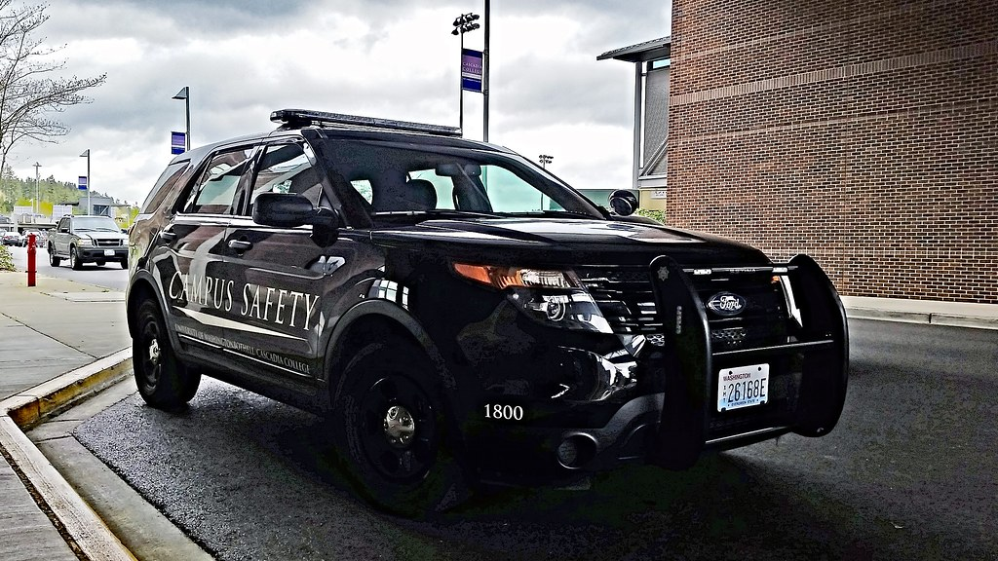
Campus Security
Located below the sky bridge
Available 24/7
Can be reached at 425-352-5359
Cham Kao, Director

Slide 3
Here to help
Prompt Reporting, if you see something, say something.
Safety Escorts
Battery Jump
Building Admit
Key Card Access
Lost & Found

Slide 4
Emergency Numbers
Emergency Numbers for Police/ Fire/ Medical
9-1-1

