Slide 1
Active Shooter
Cascadia College

Slide 2
Be Prepared
Be aware of your surroundings
Note exit routes and hiding places
Develop a plan

Slide 3
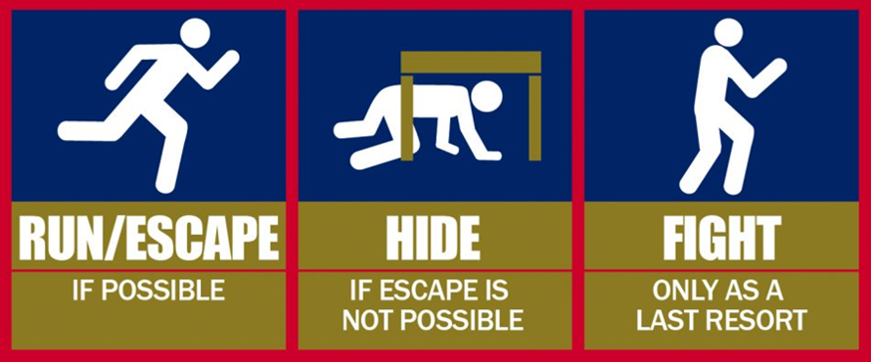
What to do if there is an active shooter on campus
Run, get away if you can do so safely
Leave your belongings behind
If you can’t escape, find a good place to hide
Turn off lights
Lock and blockade the door
Remain quiet and silence cell phone
Stay away from windows
Call 911

Slide 4
If the shooter is nearby
Make a plan of action even if the shooter is not close at the moment
Use your best judgment
Fight: do what’s necessary to survive
Act unconscious
Flee if possible

Slide 5
Next steps
Wait for emergency responders to give the all clear
They will go door to door and escort you out
Follow all of their instructions carefully: walk calmly, raise hands, don’t worry about collecting your belongings
Notes:
Change photo

