Slide 1
Campus evacuation procedure
Cascadia College

Slide 2
When The fire alarm sounds
The elevator will stop working
The metal gates and wooden hall doors will close
Building doors will lock with no re-entry

Slide 3
Make sure to immediately
Collect your belongings
Follow instructions of evacuation team member if present
Leave the building towards the nearest exit
Gather at the unification point nearest your exit

Slide 4
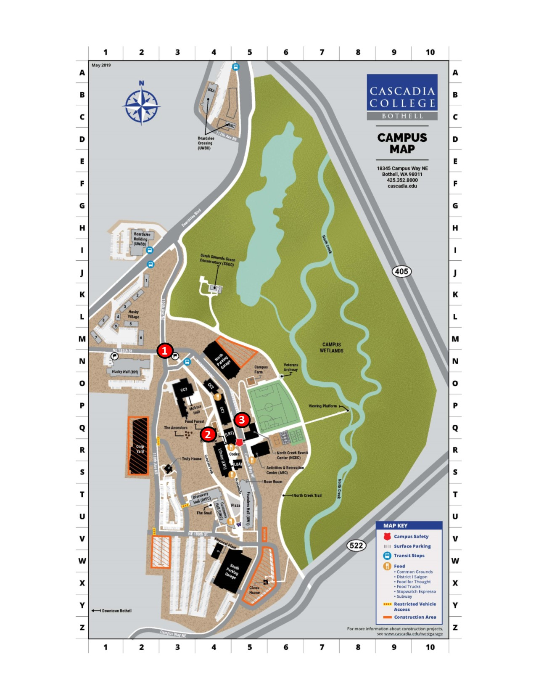
Unification points
Flag Pole (1): Anyone leaving building CC2 via north exits (towards bus stop) or CC3
Far Side of Campus Way (2): Anyone exiting CC1/2 via lower level main entry or CC1 south exit go towards sports field near the smoking tent
Food Forest (3): Anyone exiting CC1 at first level promenade main entry or south exit and gather on arch pathway
Wait for an Evacuation Team Member for next steps or with an ALL CLEAR.

Slide 5
Next steps
Wait for an Evacuation Team Member for next steps or with an ALL CLEAR.

