Slide 1

Earthquake
Cascadia College

Slide 2
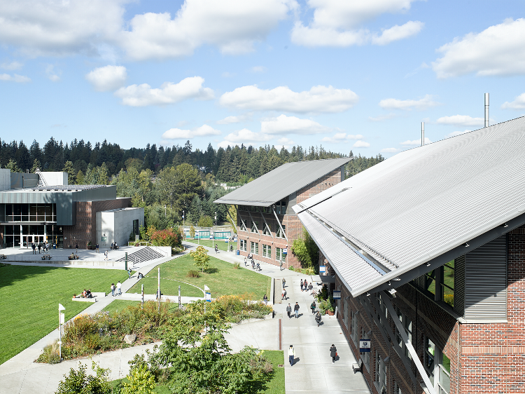
Campus buildings and facilities
Our campus buildings are engineered to withstand high-magnitude earthquakes
When shaking begins the metal gates and wooden doors will automatically close

Slide 3

If you are outside
Move away from street lights, utility wires, and all buildings (including the garages)
Head to an open space and stay there until shaking stops

Slide 4
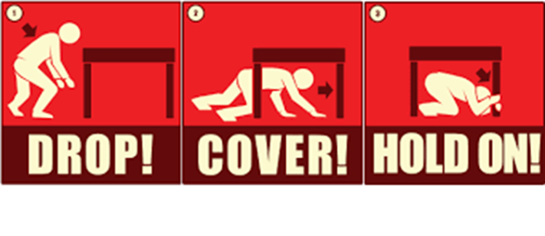
If you are Indoors
Move away from windows, outside walls, and anything that could fall on you
Drop to the floor and take cover under a desk/table and hold in place
If that is not an option, shelter against an interior wall and cover face with arms
Stay inside until shaking stops

Slide 5

When shaking stops
Campus security will use the PA system speaker to announce when it’s safe to leave the building
Evacuation team members will be in the hallways equipped with walkie-talkies and backpacks with emergency supplies
Follow the exit signs
Do not use elevators or go in garage
Go to nearest reunification point

